Slide 1
GYNAECOGICAL CANCERS: CLINICAL PRACTICE GUIDELINES
Dr Rema P
Division of Gynaecological oncology
RCC, Thiruvananthapuram

Slide 2
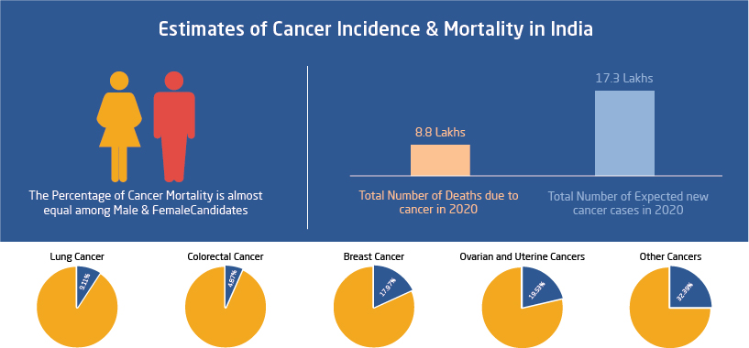

Slide 3
Surgical management of cervical cancers

Slide 4
Early cervical cancervical cancer
Stage IA1 Stromal invasion upto 3mm in depth
Stage IA2 Stromal invasion 3-5 mm in depth
Stage IB Clinical lesions confined to the cervix or pre-clinical lesions >stage IA2
Stage IB1 Lesions ≤ 2 cm
Stage IB2 2-4 cm

Slide 5
Pretreatment evaluation
Pelvic examination
Cervical smear
Colposcopy and biopsy
Conization

Slide 6
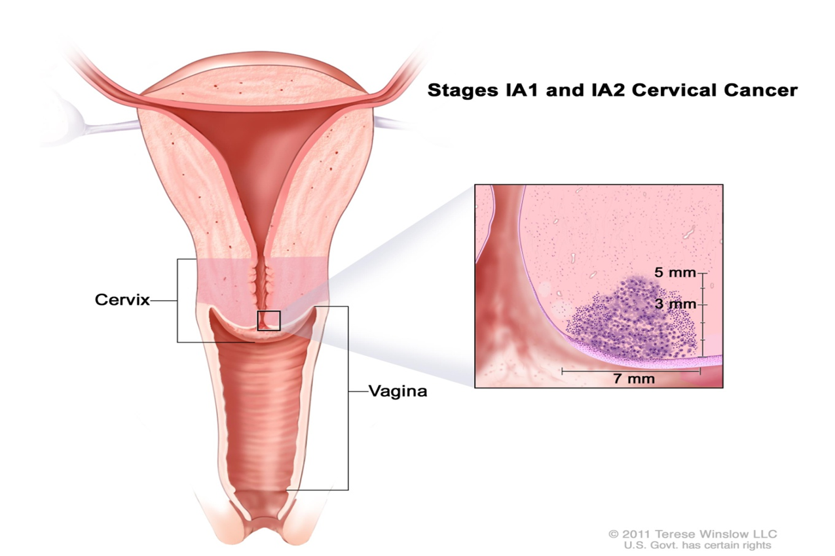
Micro invasive disease – diagnosed by conisation

Slide 7
Stage Ia1
Microinvasive disease
Incidence of lymph node metastasis<1%
pelvic lymphadenectomy is not necessary
Conisation/ Simple hysterectomy

Slide 8
Stage 1a2
Type B RH +bilateral pelvic LN dissection
Incidence of LN metastasis is 7-9%
Patients desiring fertility –
Radical trachelectomy +BPLND
Medically unfit patients –
Radical RT

Slide 9
Principle of treatment
Single modality treatment
Surgery or Radiotherapy
Never both
Combination of surgery and radiotherapy- doubles complications
Ideal patient selection

Slide 10
Stage IB1,B2 and IIA1
Type C radical hysterectomy(RH) +pelvic lymph node dissection(BPLND)
Comparable results with surgery and RT

Slide 11
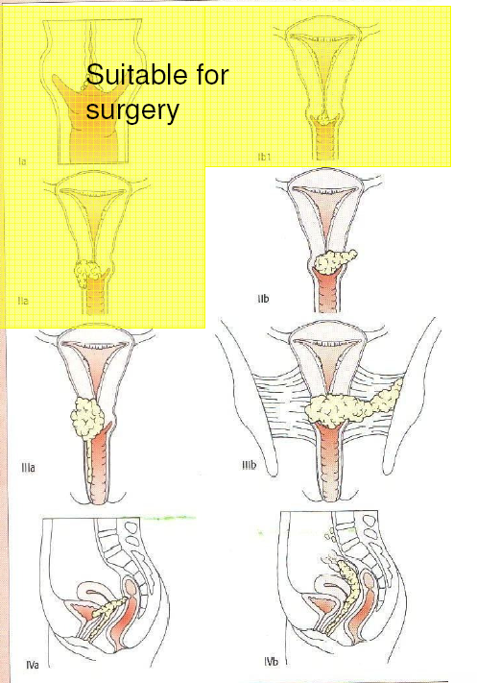

Slide 12
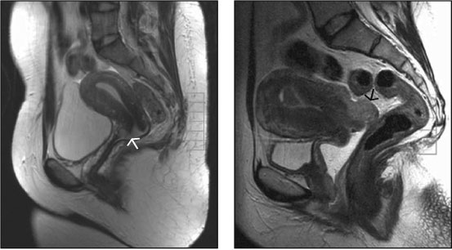
Imaging
MRI
Tumor size – 93% accuracy(Subak et. al)
Stromal invasion –78% accuracy
Parametrial invasion – 94% accuracy

Slide 13
Treatment options
Cancer cervix | Treatment | Cure rate
Early stage (IB1,B2 and IIA1) | Surgery / Radiation | 90-100%
Advanced stage | Chemo-radiation | 25-50%

Slide 14
Early Cervical Cancer- Surgery vs radiotherapy
accurate evaluation of disease
preservation of ovarian function
sexual function
complications amenable to treatment

Slide 15
Surgery vs radiotherapy
RT leads to progressive obliterative endarteritis leading to appearance of complications years after treatment
RT leads to vaginal stenosis,mucosa becomes thin and fragile
Patients with surgery are better psychologically

Slide 16
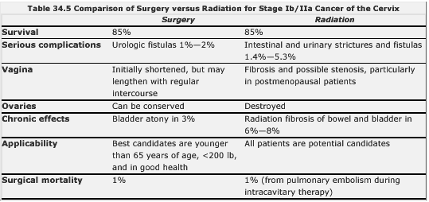

Slide 17
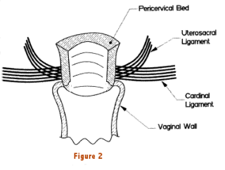
Principle of Radical hysterectomy
Radical hysterectomy requires removal of cervix with corpus, parametrium, paracolpos and upper 2 cm vagina
Combined with Pelvic node dissection
Central tumour removed with adequate margin of normal tissue

Slide 18
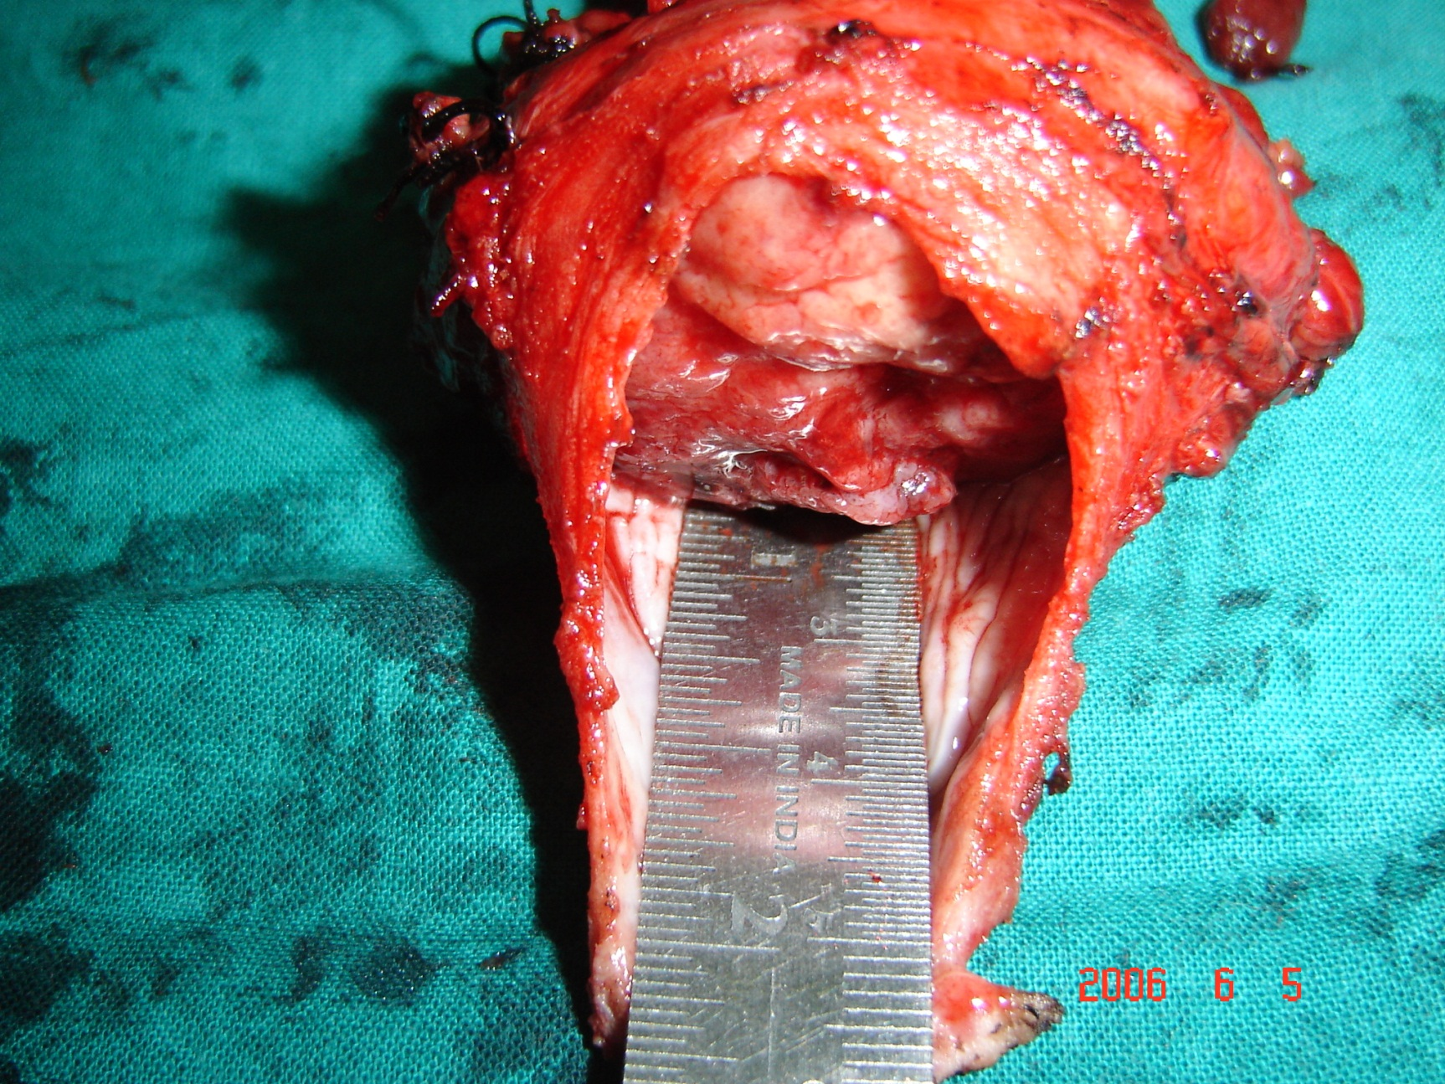

Slide 19
Concurrent ChemoRadiation
Chemo
Cisplatin 40mg/m²
External Beam RT
Whole pelvis - 4000-6000 cGy
Over 4-5 weeks
Brachytherapy
Intracavitary HDR
8Gy in 3 sittings

Slide 20
Five-Year Survival: Cervix
from Grigsby, P.W., et.al Radiother Oncol 12:289, 1988

Slide 21
Endometrial cancers

Slide 22
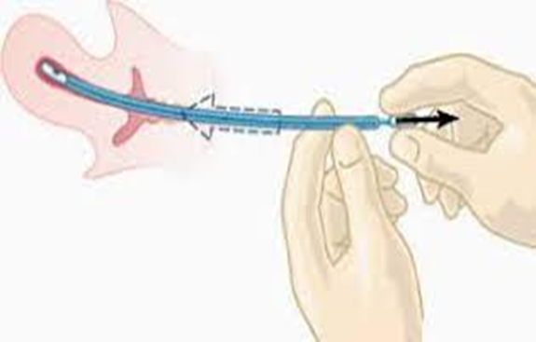
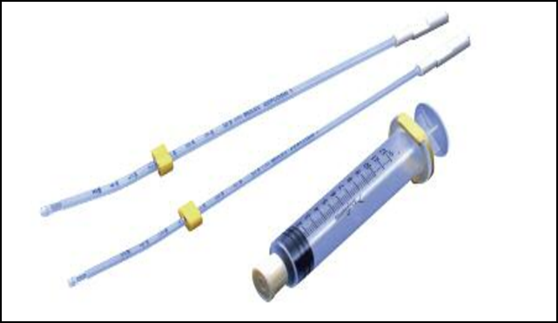
Diagnostic Evaluation
Confirm with histopathology
Endometrial Biopsy
D&C- if biopsy inconclusive
Hysteroscopy - if still inconclusive
Look for-
Histological subtype
Grade

Slide 23
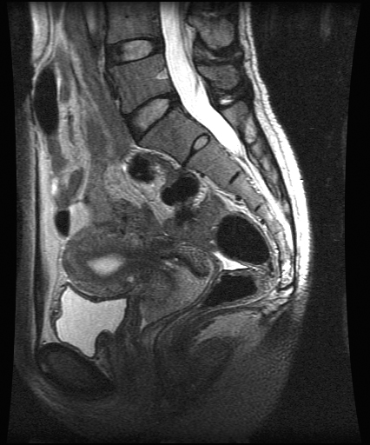
Diagnosis – Cancer Endometrium
MRI
Better predictor of myometrial invasion and cervical involvement
Useful if planning treatment

Slide 24
Pre surgical prognostic factors
Stage at diagnosis
Histological grade
Myometrial invasion and cervical involvement
Lymph node involvement
The stage of cancer endometrium at initial diagnosis is the most important prognostic factor

Slide 25
Surgical Staging
Staging in endometrial cancer is always surgical- Open/ Laparoscopic
Total abdominal hysterectomy and bilateral salpingooophorectomy is the treatment of choice
In all high risk cases pelvic and paraaortic lymphadenectomy is advisable

Slide 26
Surgical management
Basic surgical treatment
Cytology
Total hysterectomy
Bilateral salpingooophorectomy
Pelvic , para aortic LND
Stage 2 cancers
Radical hysterectomy for parametrial resection
Type 2 cancers – Clear cell, Serous ca
Omentectomy, peritoneal biopsies

Slide 27
Can we identify a subset of patients who will not benefit from lymphadenectomy?
Criteria indicative of low risk of nodal mets
Well or moderately differentiated
< 50 % myometrial infiltration
Tumour size < 2 cm
Pre operative MRI
Intra operative frozen section

Slide 28

Lymphadenectomy – indications…
Low risk – 1A Gr 1/2
No lymphadenectomy
Intermediate risk - 1B Gr1&2, 1A gr3
lymphadenectomy can be considered
High risk – 1B Gr 3 & Non endometriod
- lymphadenectomy recommended
If Lymphadenectomy- Pelvic & Paraaortic needed

Slide 29
Update on surgery in endometrial cancer
GOG LAP2 trial – Surgical staging by laparoscopy safe
Sentinel node biopsy for early stage endometrial cancer
SENTI – ENDO published in 2011
Sensitivity & NPV 100%
Correctly identifies pt for adjuvant treatment

Slide 30
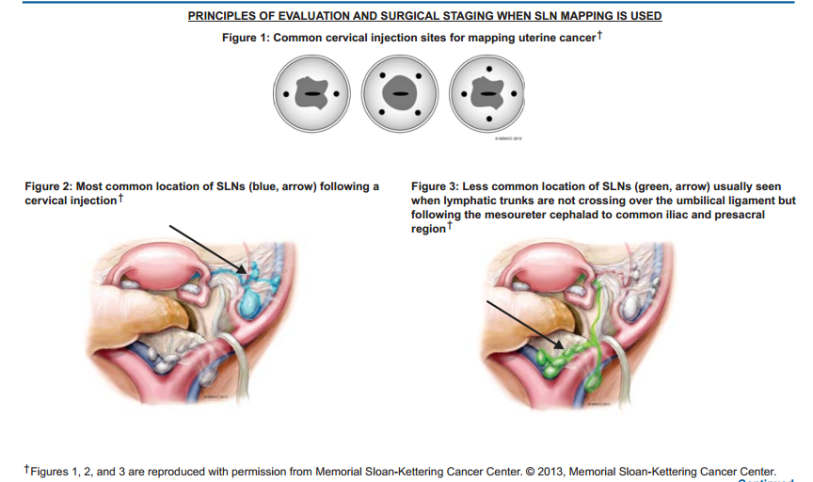

Slide 31
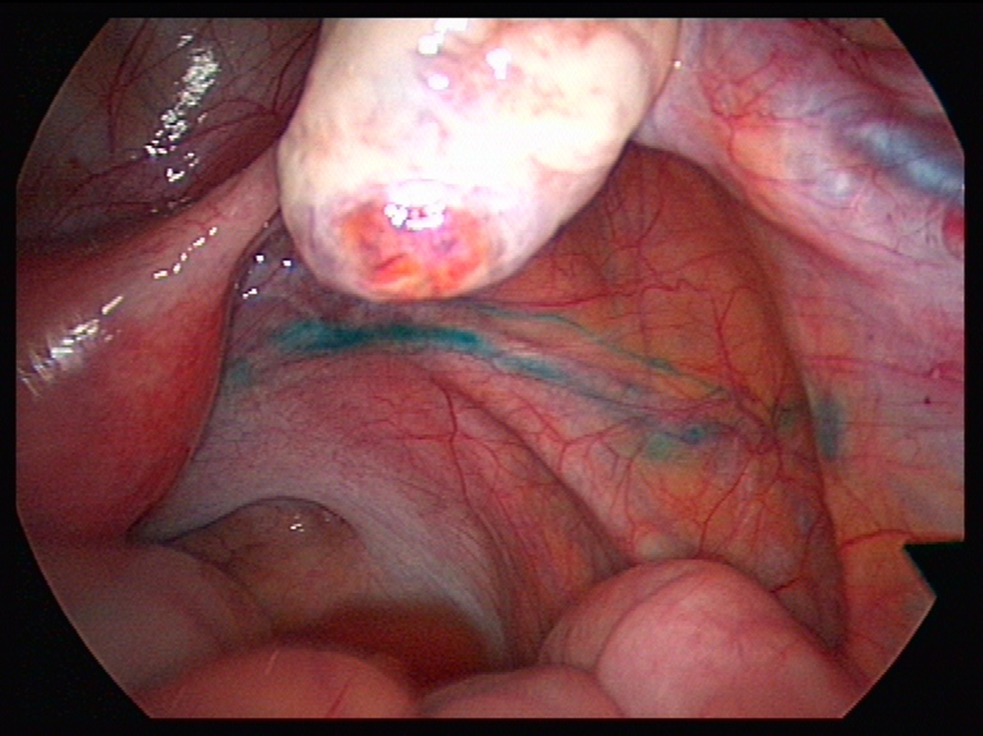

Slide 32
Ovarian preservation in endometrial cancer
Ovaries can be preserved if…
< 45 years
Low risk <50% MI, Grade 1, endometriod
No extra uterine disease
Salpingectomy should be done
Not recommended if family history/ BRCA

Slide 33
Cancer endometrium - summary
TAH, BSO alone in early stage
LN dissection, Adjuvant RT - with high risk features
Cytoreductive surgery followed by chemo RT in advanced cases

Slide 34

Improving gynaecological cancer care – Role of MDTs

Slide 35
Thank you…
Thank you

